Slide 1
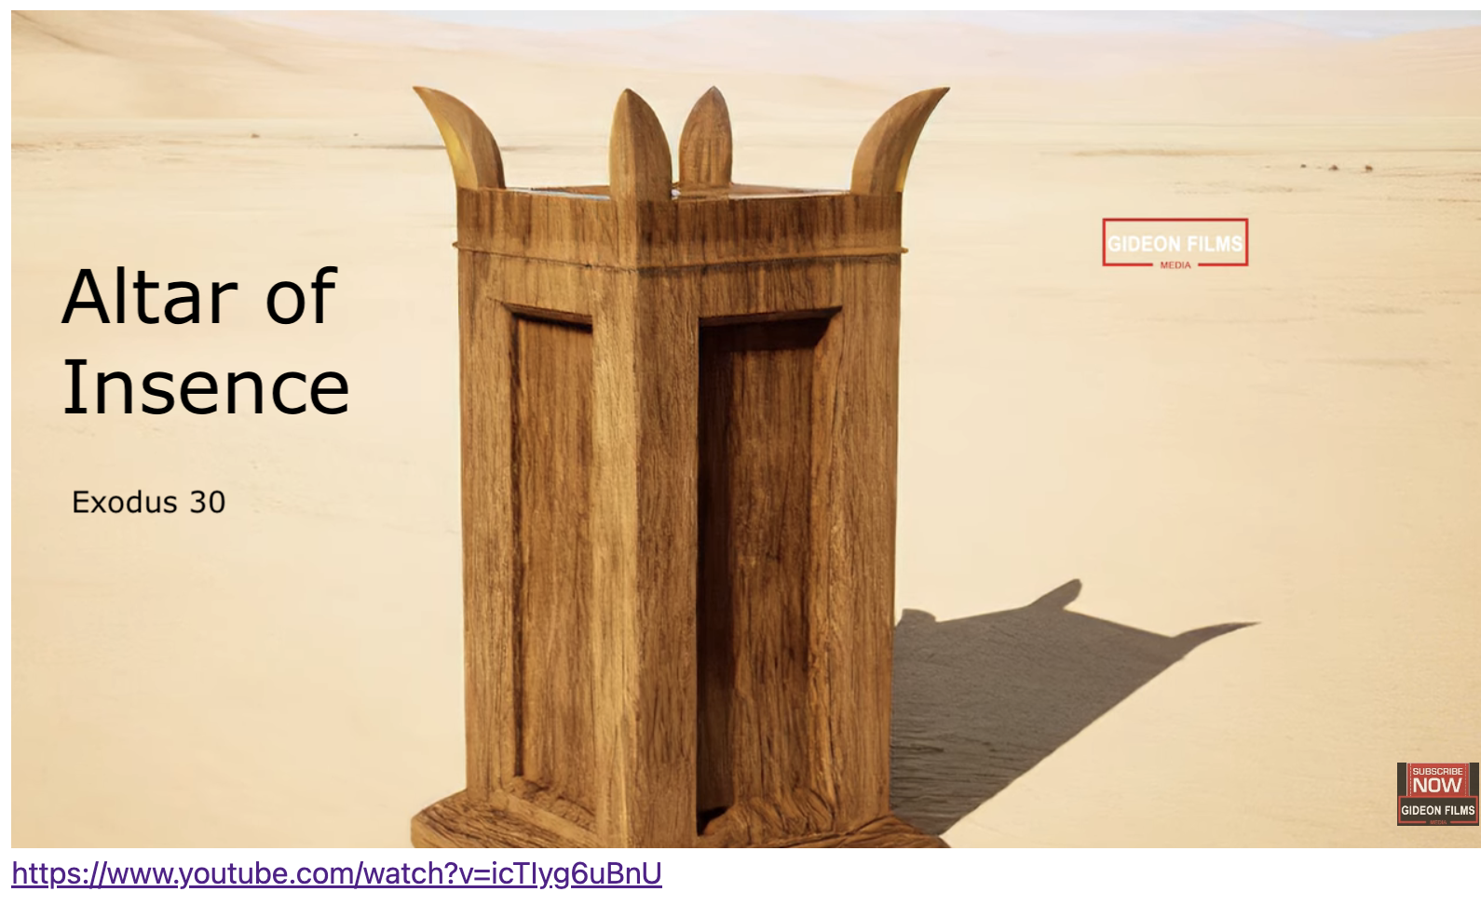
Exodus 出埃及記 30:22-33 The Sacred Incense
親子靈修 William分享
09-13-2025

Slide 2
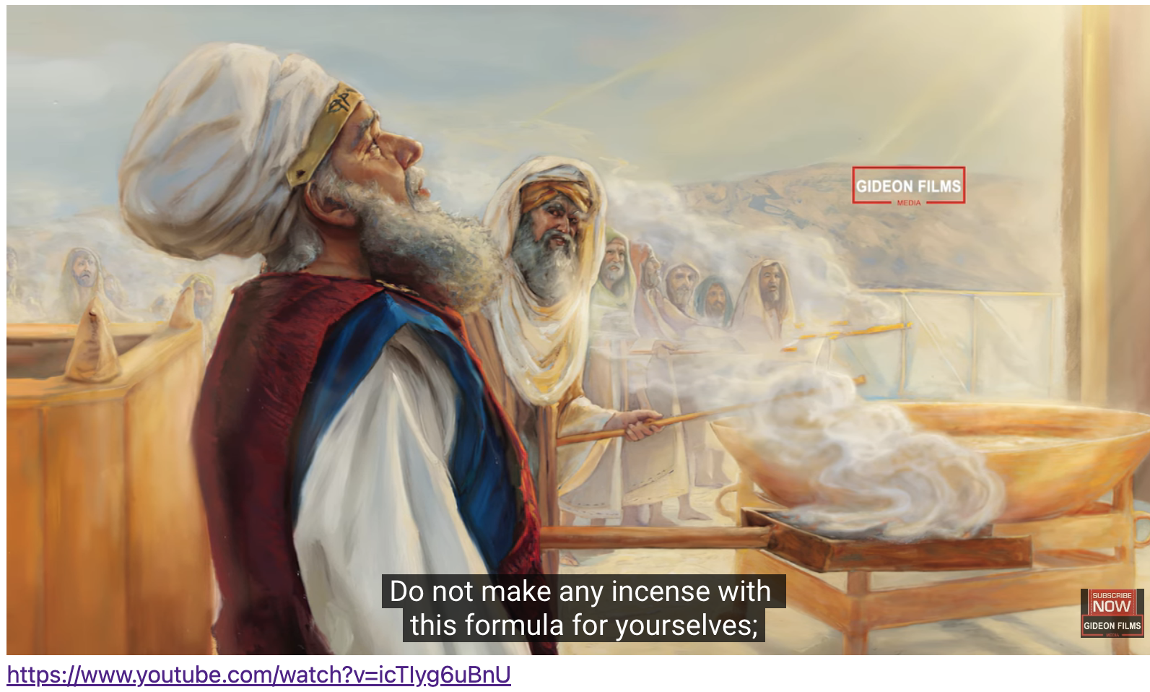
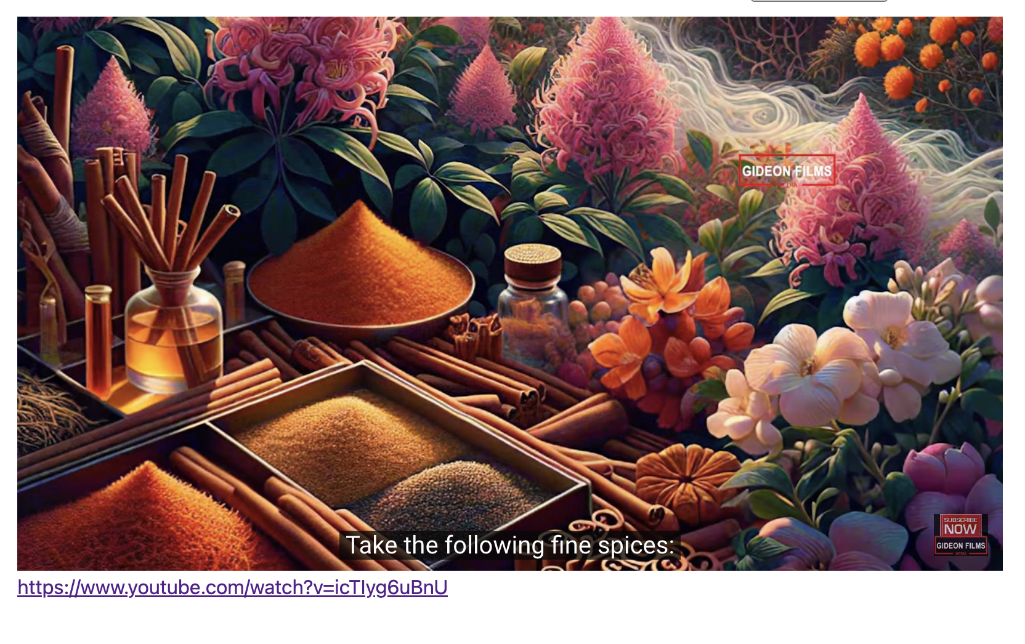
https://www.youtube.com/watch?v=icTIyg6uBnU English Version Video: Exodus 30:01-10.
(1 min)

Slide 3
Lord’s Warning
The Lord Said to Moses:
"Do not make any incense with this formula for yourselves; consider it holy to the Lord ." (Exo30:37 NIV)
"你们不可按这调和之法为自己作香、要以这香为圣、归耶和华。" (Exo30:37 CUVS)
"Whoever makes any like it to enjoy its fragrance must be cut off from his people." (Exo30:38 NIV)
"凡作香和这香一样、为要闻香味的、这人要从民中剪除。" (Exo30:38 CUVS)

Slide 4
Jesus’ Warning
The Lord Said to Moses:
"And so I tell you, every sin and blasphemy will be forgiven men, but the blasphemy against the Spirit will not be forgiven." (Mat12:31 NIV)
"所以我告诉你们、人一切的罪、和亵渎的话、都可得赦免．惟独亵渎圣灵、总不得赦免。" (Mat12:31 CUVS)
"Anyone who speaks a word against the Son of Man will be forgiven, but anyone who speaks against the Holy Spirit will not be forgiven, either in this age or in the age to come." (Mat12:32 NIV)
"凡说话干犯人子的、还可得赦免．惟独说话干犯圣灵的、今世来世总不得赦免。" (Mat12:32 CUVS)

Slide 5
Role of Salt
The Lord Said:
"and make a fragrant blend of incense, the work of a perfumer. It is to be salted and pure and sacred." (Exo30:35 NIV)
"你要用这些加上盐、按作香之法作成清净圣洁的香。" (Exo30:35 CUVS)

Slide 6
Role of Salt
Jesus Said:
"You are the salt of the earth. But if the salt loses its saltiness, how can it be made salty again? It is no longer good for anything, except to be thrown out and trampled by men." (Mat5:13 NIV)
"你们是世上的盐．盐若失了味、怎能叫他再咸呢．以后无用、不过丢在外面、被人践踏了。" (Mat5:13 CUVS)

Slide 7
Advice
Apostle Paul Said:
"Therefore, I urge you, brothers, in view of God's mercy, to offer your bodies as living sacrifices, holy and pleasing to God -- this is your spiritual act of worship." (Rom12:1 NIV)
"所以弟兄们、我以 神的慈悲劝你们、将身体献上、当作活祭、是圣洁的、是 神所喜悦的．你们如此事奉、乃是理所当然的。" (Rom12:1 CUVS)

Slide 8
個人反思 & 教養智慧
個人反思 Personal Reflection：
What is the meaning of being the salt in the family and the world? Am I raising my children for myself or for God?
教養智慧：
"The fear of the Lord is the beginning of knowledge, but fools despise wisdom and discipline. Exhortations to Embrace Wisdom" (Pro1:7 NIV)
"敬畏耶和华是知识的开端．愚妄人藐视智慧和训诲。" (Pro1:7 CUVS)

Slide 9
Closing Prayer
Dear Heavenly Father, the Glorious Lord, the Creator, and Sovereign of all things. Thank you for your mercy and grace. Thank you for calling us, the parents. Thank you for giving us, the parents, the educational authority. Our children are your heritage. We are the sinners; we do not deserve it. May Your Holy Spirit call us, guide us. Bless our children and young generation to be able to know you, follow you to be the devotional generation. May your name be glorified, generation by generation, and forever. I pray in the name of Jesus. Amen.

Slide 10
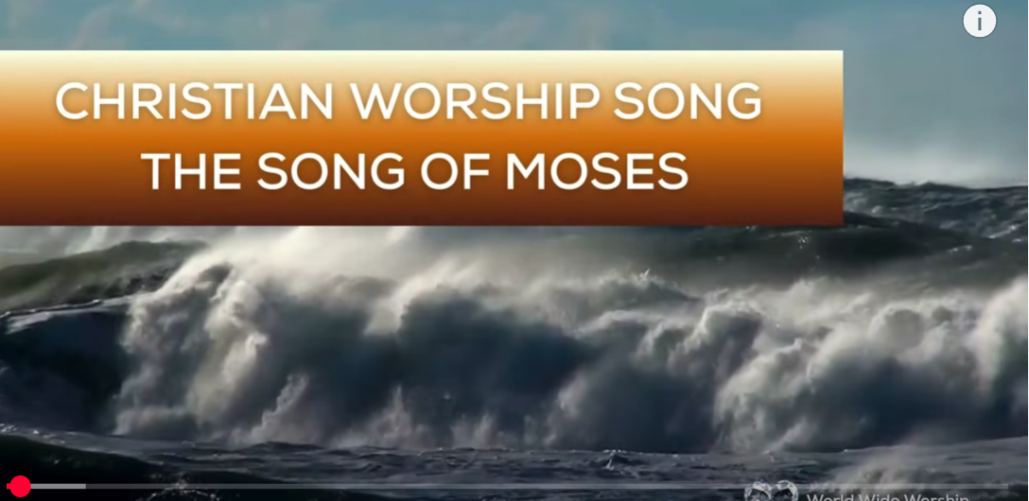
1.No Turning Back
https://www.youtube.com/watch?v=yNtid3wdDWA&list=RDyNtid3wdDWA&start_radio=1&ab_channel=GaiseBaba
Christian Kids
https://www.youtube.com/watch?v=7vihn5MpWSc&list=RD7vihn5MpWSc&start_radio=1
2. The Song of Moses https://www.youtube.com/watch?v=a-wWKL-7Mrg
The Song of Moses Like You've Never Heard Before | Christian Worship Song/ World Wide Worship

